Slide 1
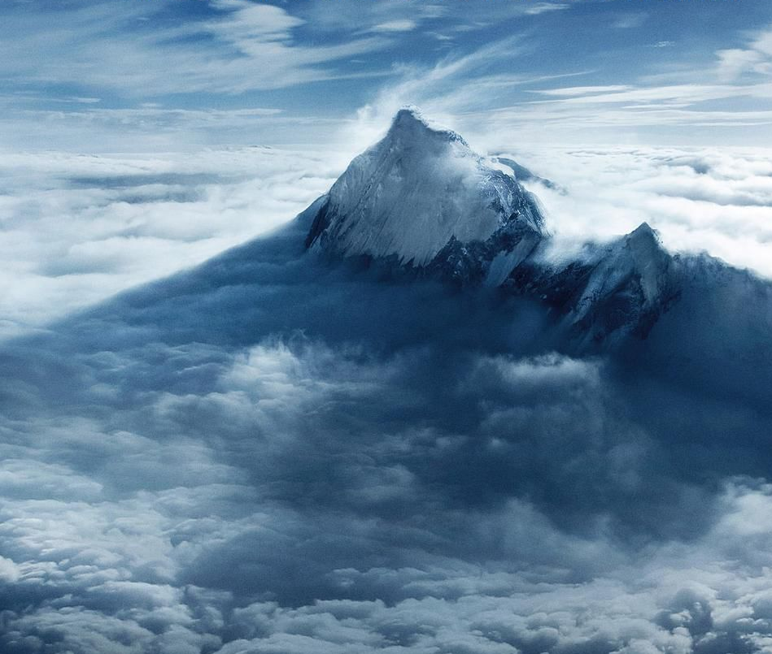
HIMALAYAS
PREDICTION
PROJECT
Group 4: Jingwen Cai, Zhenyu Cheng, Shixue Mai, Yuping Liao

Slide 2
ABOUT THE PROJECT
01
DATABASE
02
TABLE OF CONTENTS
EXPLORATORY DATA ANALYSIS & TREND ANALYSIS
03
PREDICTION MODEL
04
CONCLUSION
05
Background Introduction
Brief introduction of the database
Statistical Graph
Logistic Regression
Gradient boost machine in classified bernoulli distribution
Application in Real World

Slide 3
BACKGROUND
In recent years, with the development of technology and economy, more and more non-professionals want to climb the Himalayas, which has spawned many tour companies that offer non-professionals luxury climbing packages of $40,000 to $60,000. At the same time, insurance, which is one of the necessities of climbers' journeys, has also spawned a larger market. Insurance companies can provide climbers with services such as helicopter evacuation, oxygen cylinder delivery, and trip Interruption coverage.
Notes:
https://americanalpineclub.org/insurance?gclid=CjwKCAjwjZmTBhB4EiwAynRmD7NBlOr4tr_1xZbZP_VT4YLBStbVak3jgiIb0c_08u7eI8ZUvHm4SBoC-_oQAvD_BwE
https://project-himalaya.com/c-insurance.html
https://www.greathimalayatrail.com/travel-insurance/

Slide 4
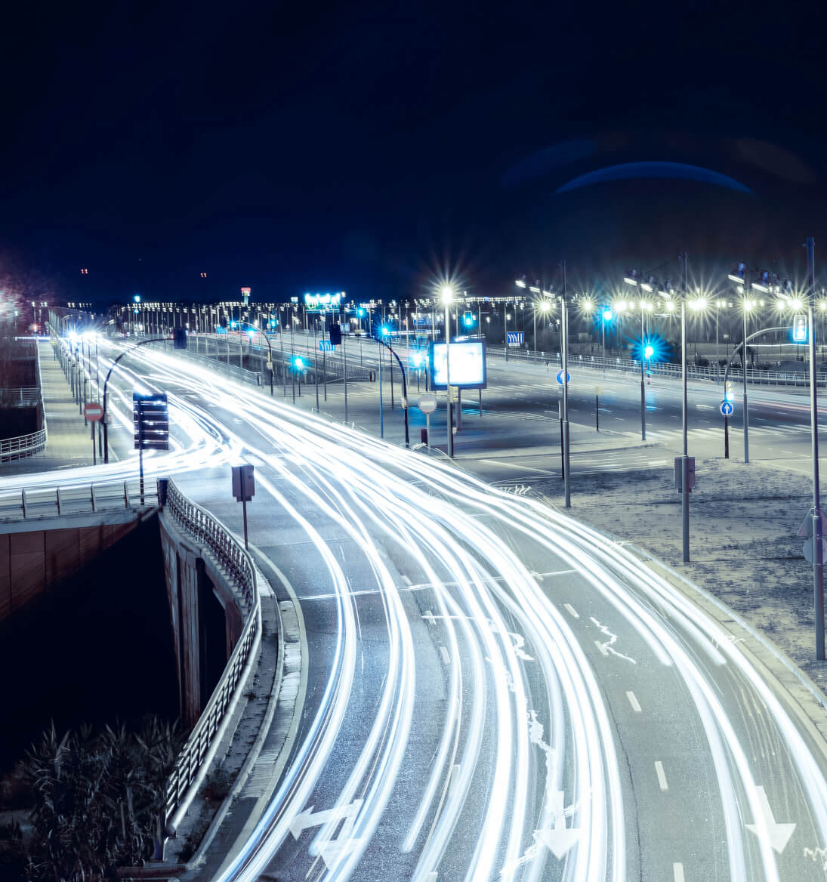
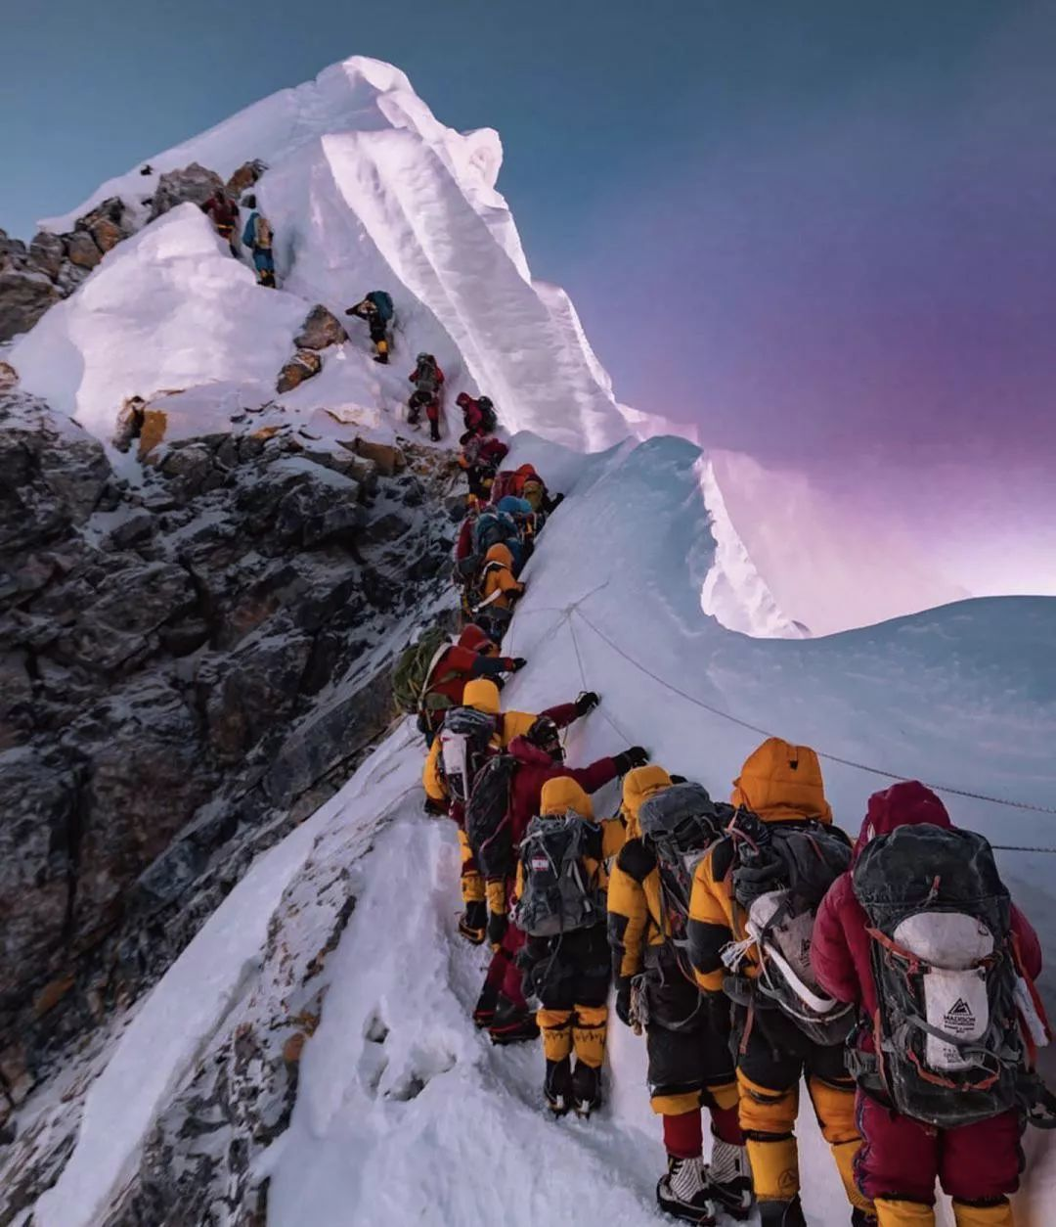
ABOUT THE PROJECT
We wanted to use the Himalayan database compiled by Elizabeth Hawley to explore the necessary factors for a successful summit and build a predictive model for the outcome of the journey.

Slide 5
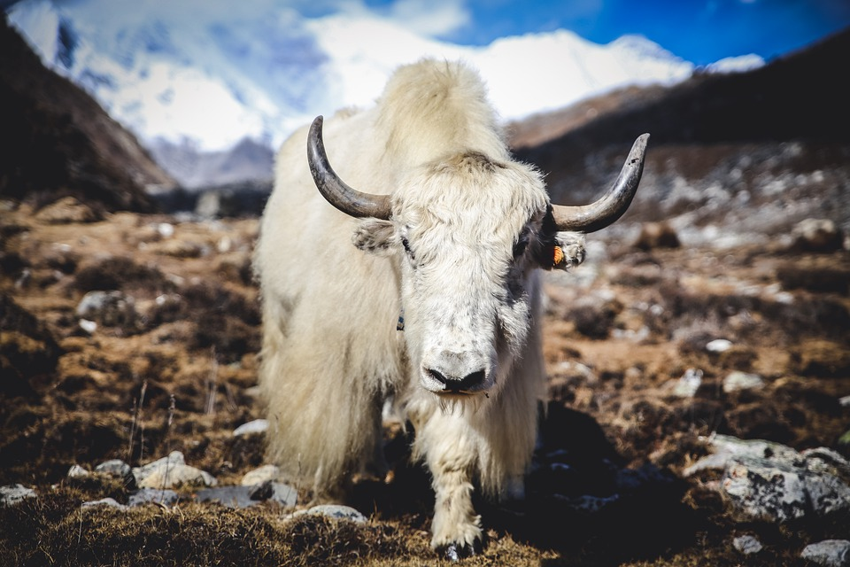
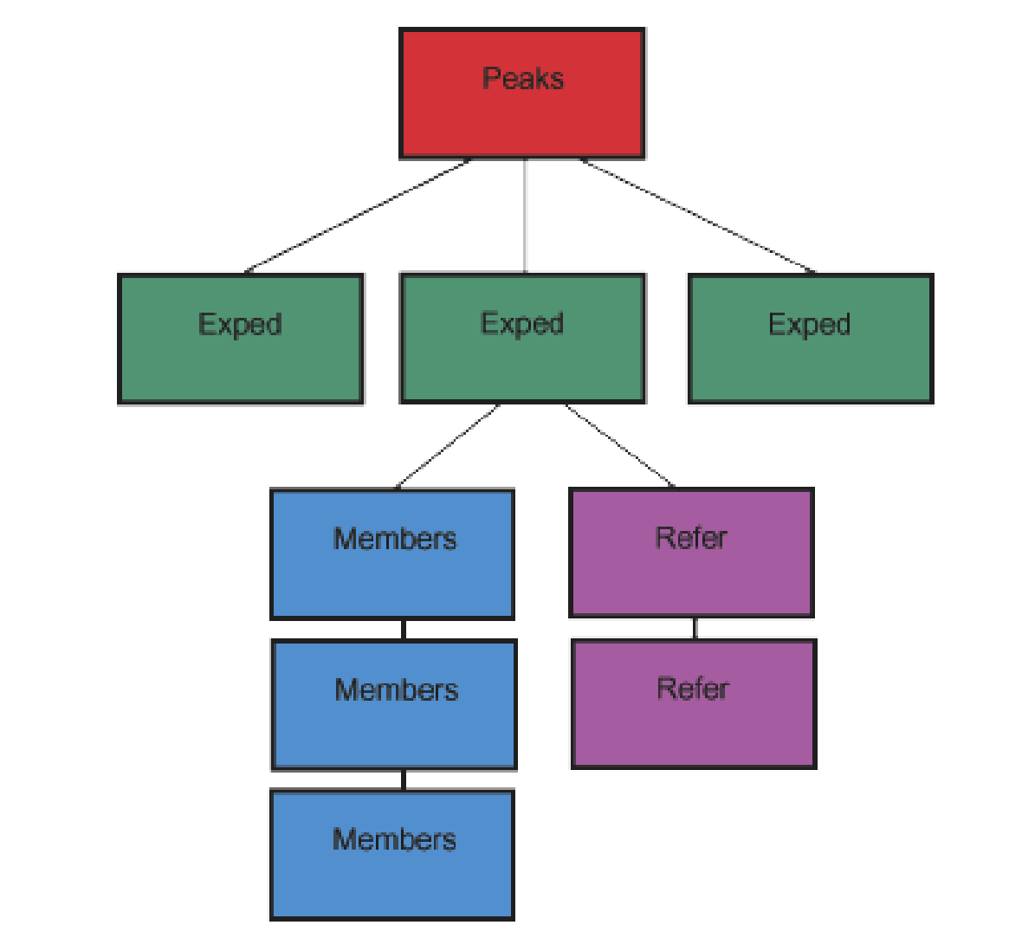
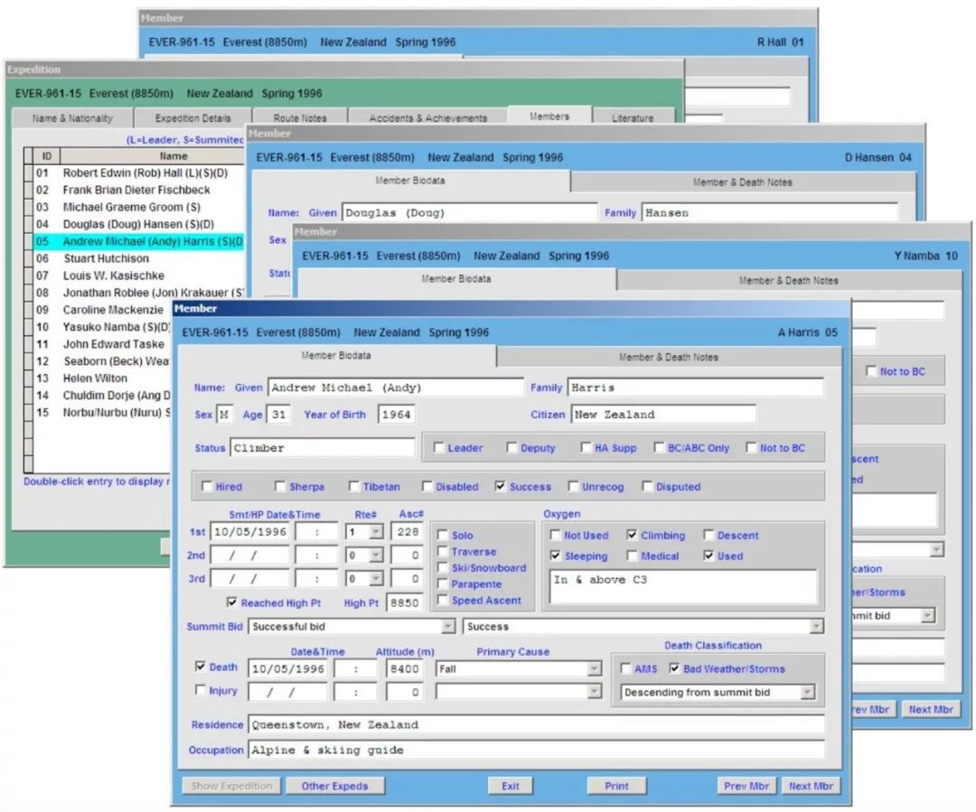
DATASETS STRUCTURE
DATABASE
DATA PROCESSING
First collected by ELIZABETH HAWLEY
Peaks records: 468
Expedition records: 10,600+
Member records: 79,200+
Aggregate variables on each expedition and join the aggregated dataset to expedition dataset based on expedition id
Conduct data binning on nation, sponsor, leader, and route variables based on their occurrence (experience)

Slide 6
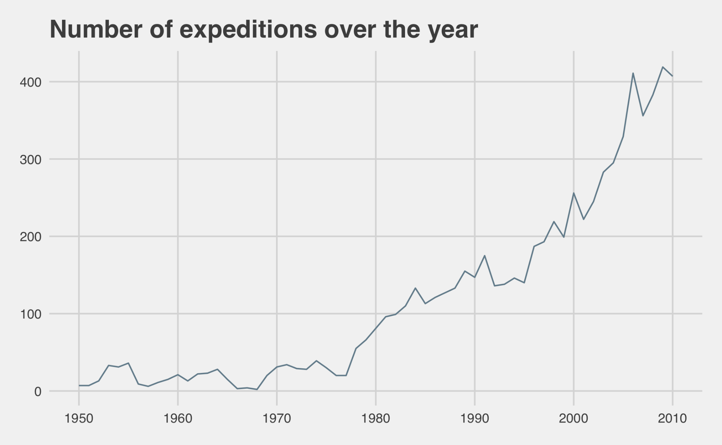
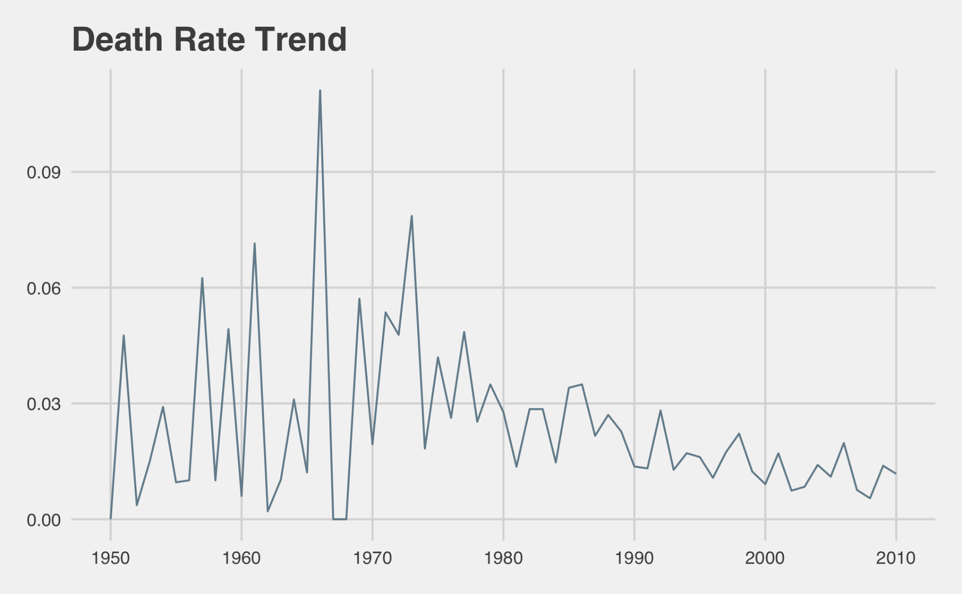
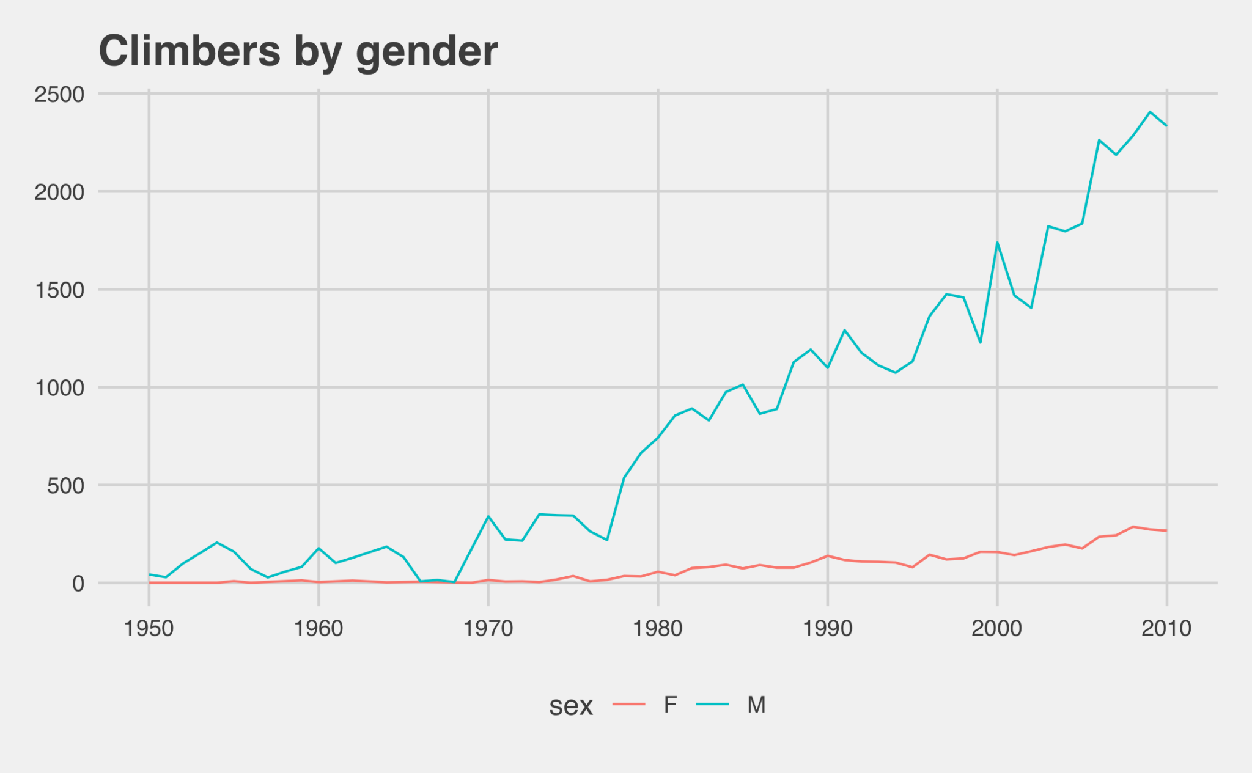
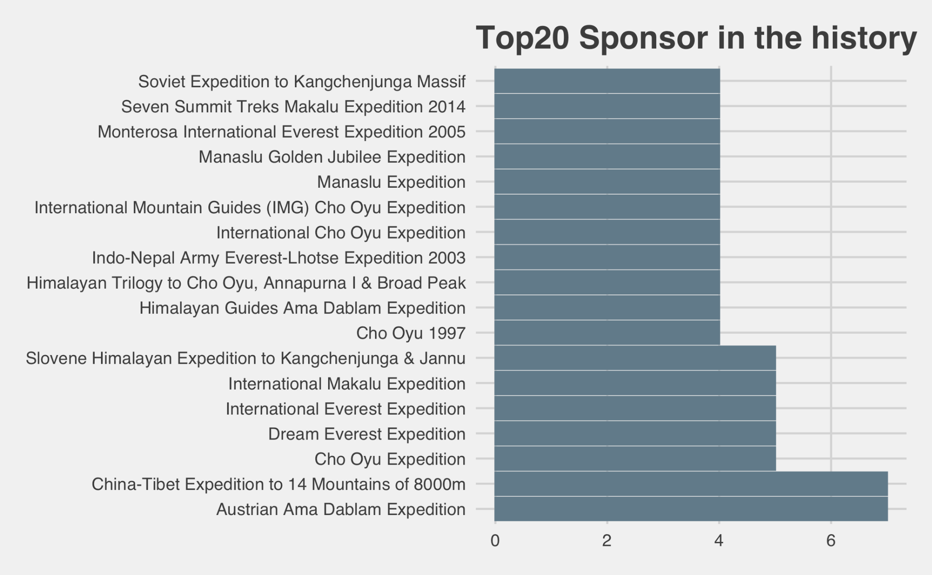
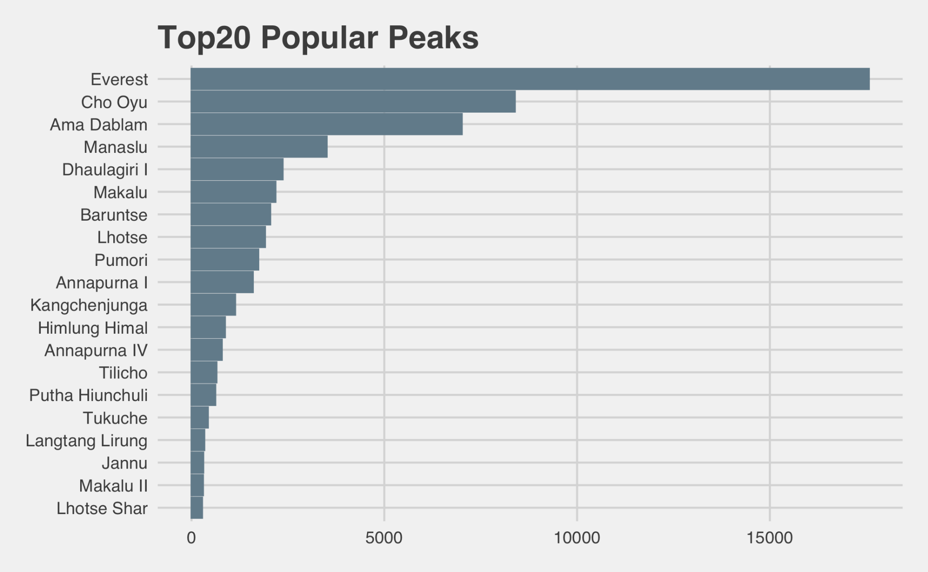
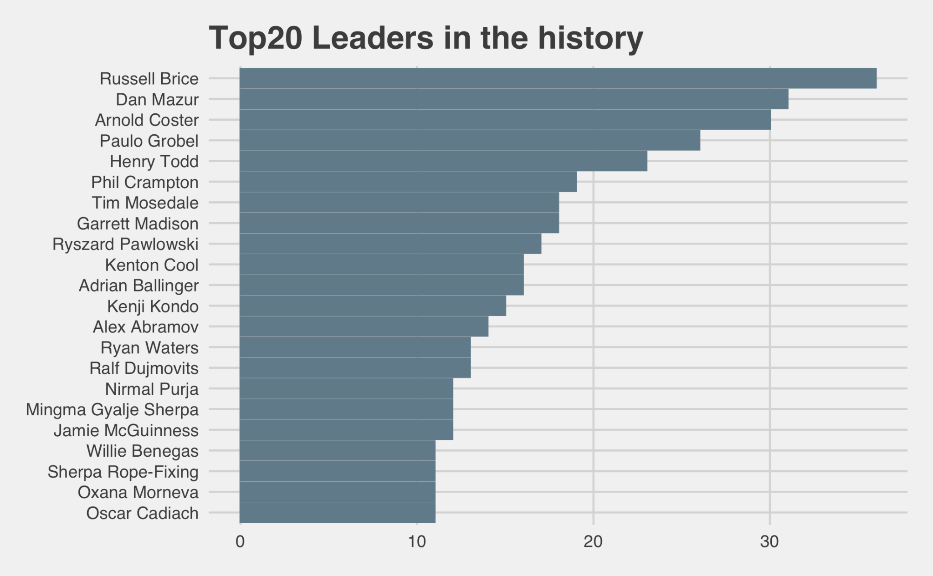
Exploration of the Himalayas increases year by year
Death rate decrease over the year
Majority climbers are male, but female climbers are increasing
EXPLORATORY DATA ANALYSIS
Most of the registered explorers are from the United States and Japan
The highest peak - Mount Everest is also the most popular mountain
Russell Brice has summited 8000m peak 14 times

Slide 7
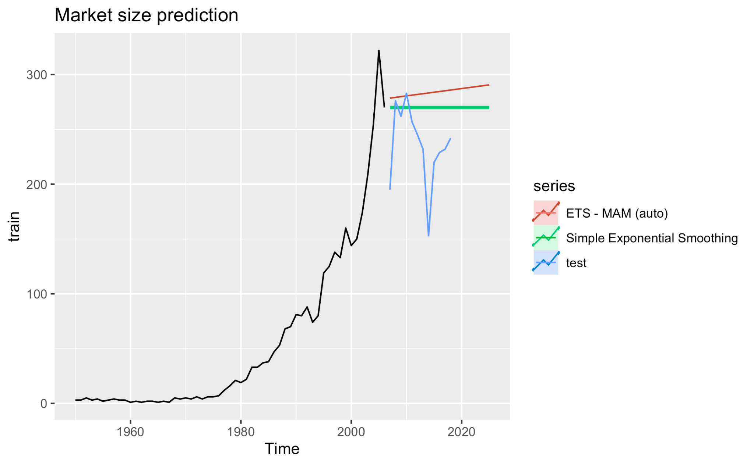
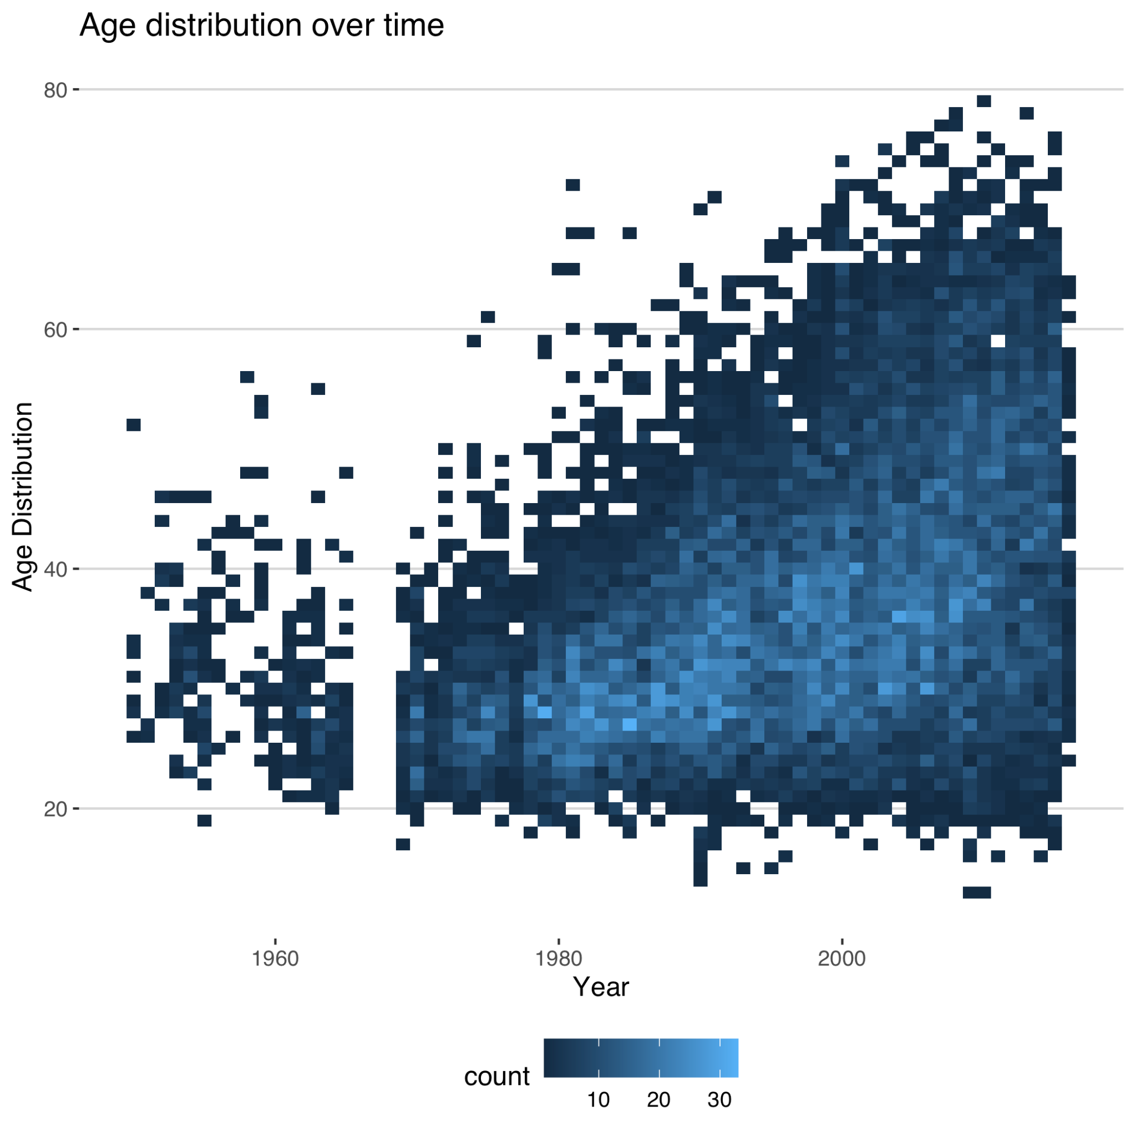
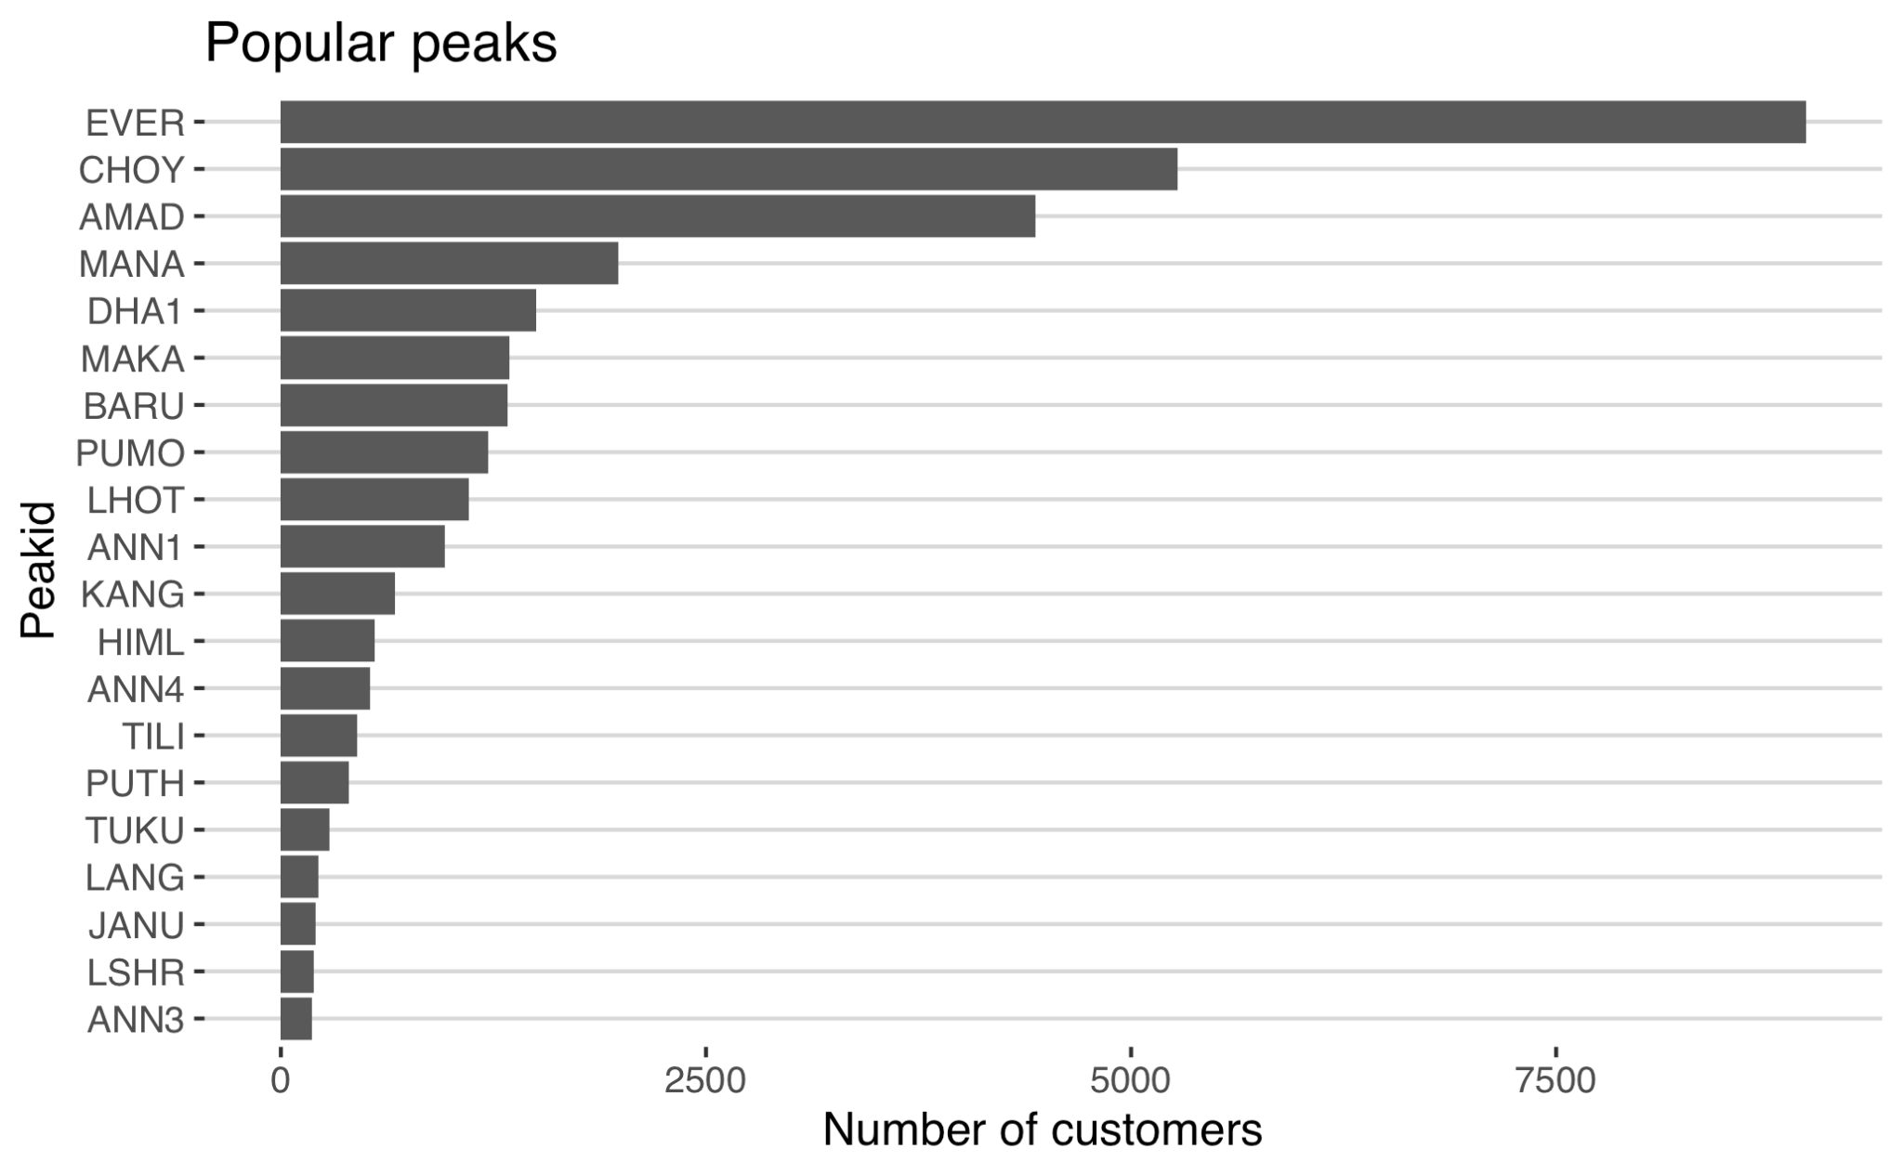
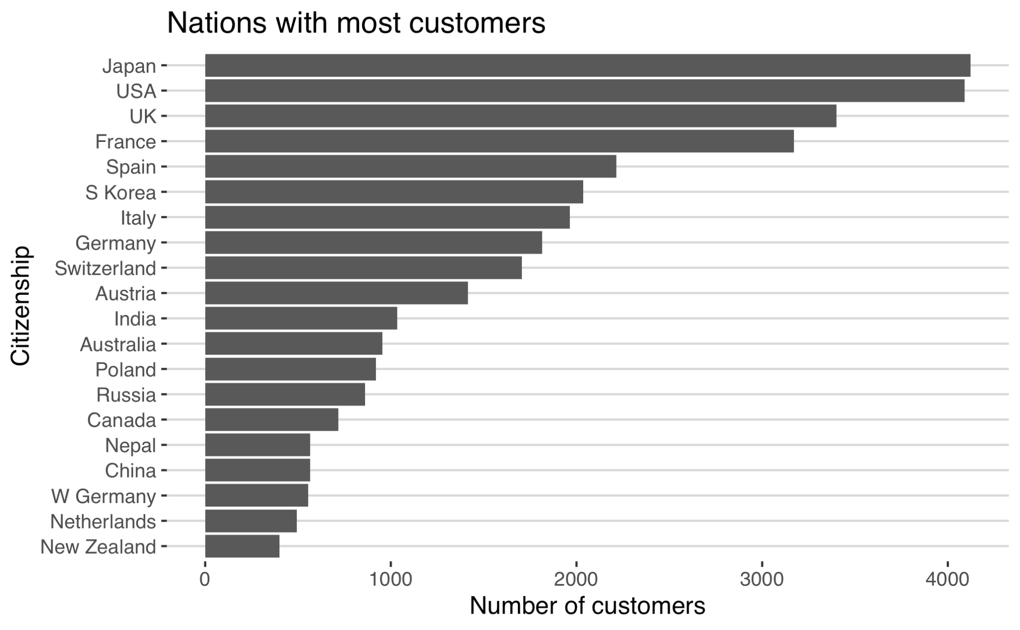
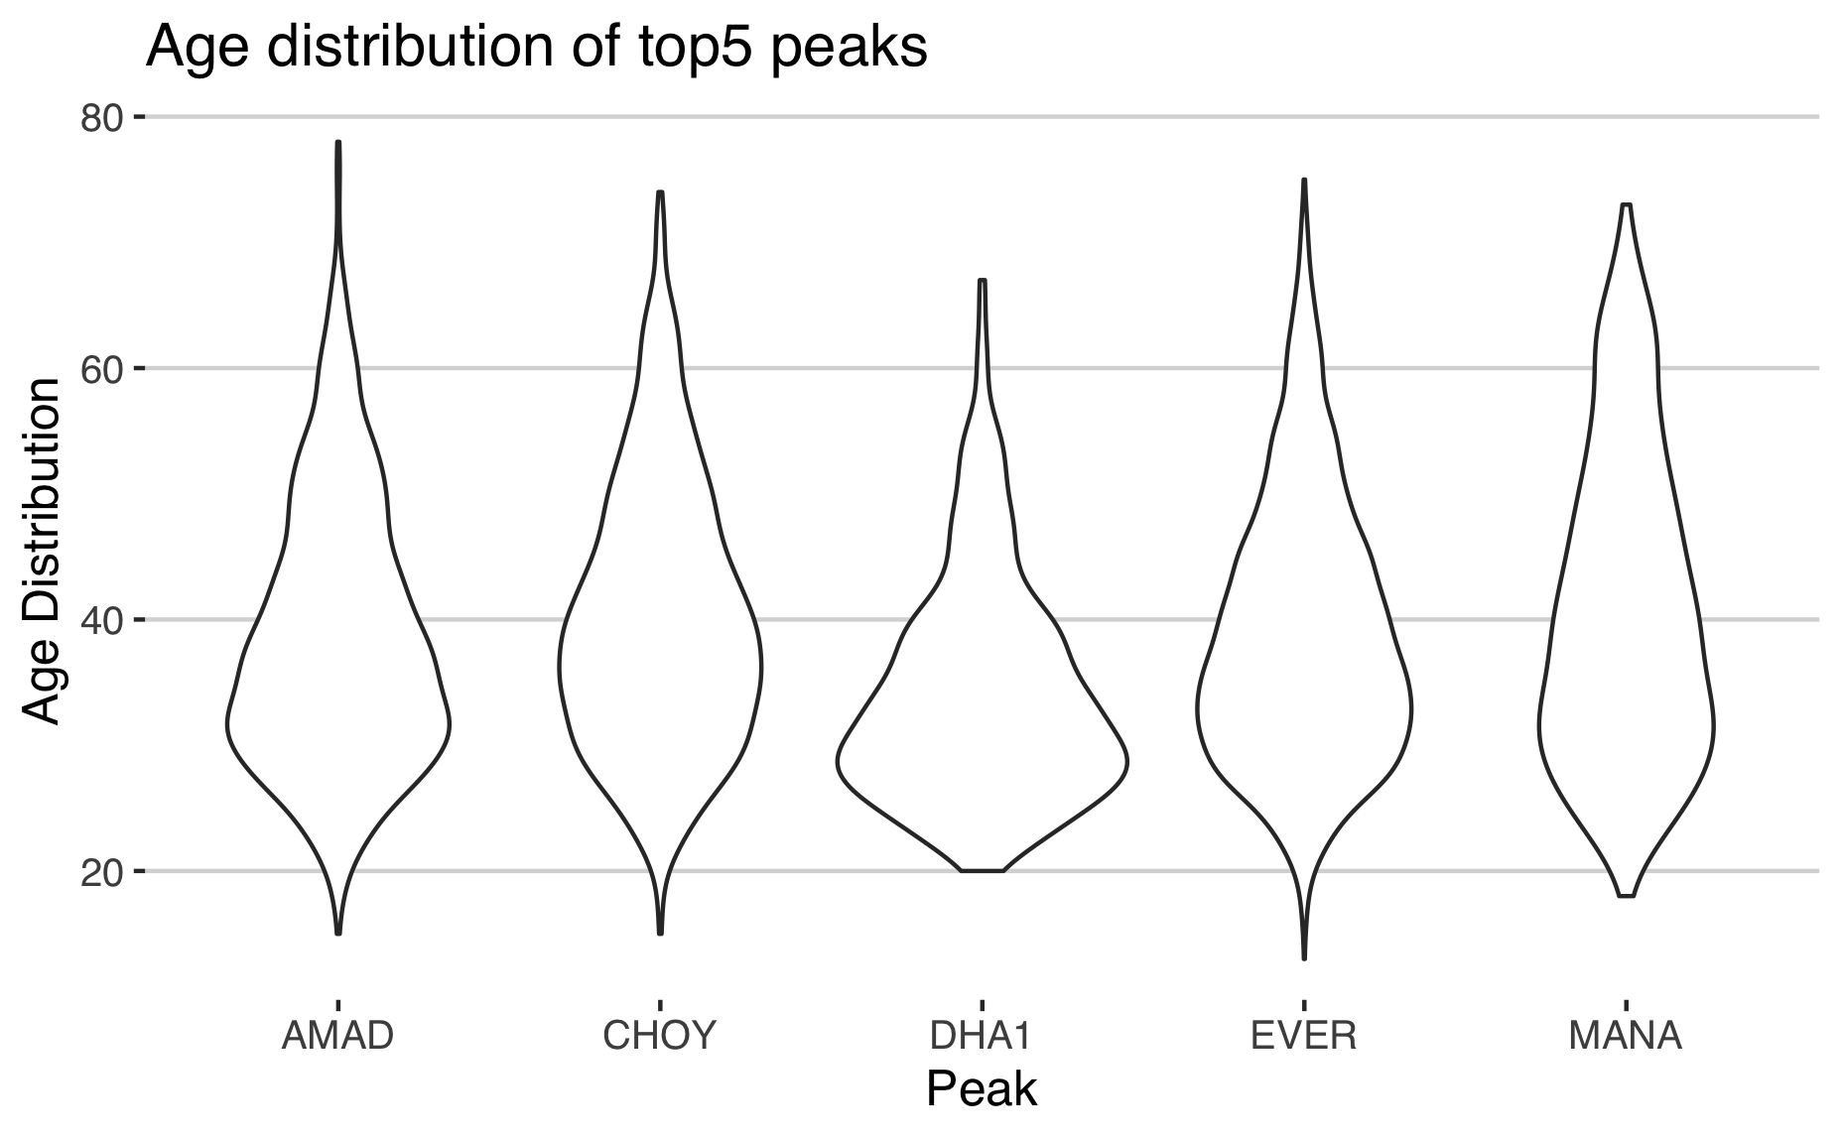
Trends Analysis
ETS model predict that the tourist market still large
Tourist age range is expanding over the year, which means age is not the burden to explore human’s limit. Middle-aged and elderly climbers can become a potential customer group for travel agencies.
According to the forecast of the ETS model, the number of climbers will continue to increase in the future, which means that the tourism market is still large.
Trends Analysis
Majority of tourists are come Japan and US
Top 5 most popular peaks choose by tourists
DHA1 is not a perfect choice for age 60+ tourists
The age range of climbers is increasing year by year

Slide 8
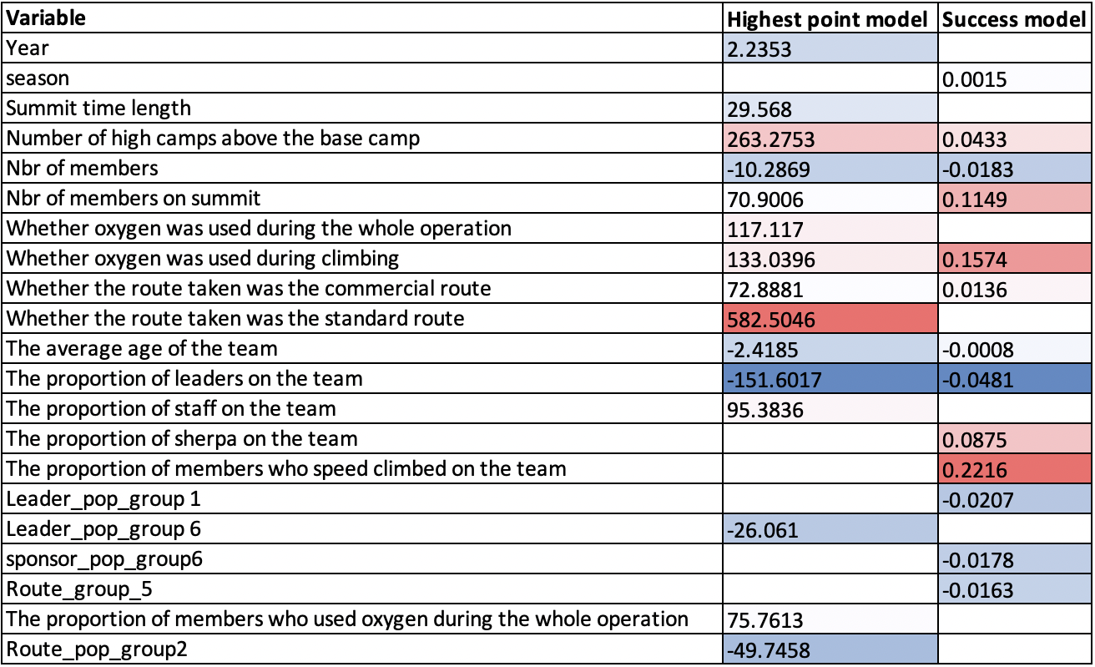
PREDICTION MODELS
Success summit prediction model
Lasso Analysis
From the results table, we can find out which factors are strongly correlated with the model results. The darker the color, the greater the correlation. Red indicates positive correlation, blue indicates negative correlation.
Highest point prediction model
Gradient boost machine in classified bernoulli distribution (h2o package)
Accuracy Measure | Logistic Regression | Gradient Boost Machine | Neural Networks
Accuracy | 0.609 | 0.969 | 0.984
Specificity | 0.997 | 0.991 | 0.984
Sensitivity | 0.229 | 0.948 | 0.985
Gradient boost machine in gaussian distribution (h2o package)
Model | RMSE
Linear Regression | 1221
Gradient Boost Machine | 898
Neural Networks | 892

Slide 9
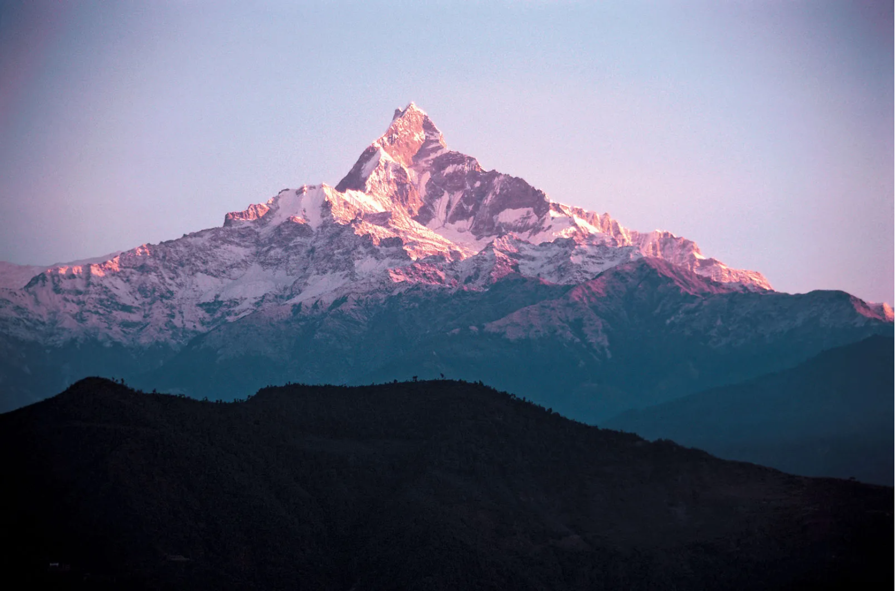
CONCLUSION
INSURANCE COMPANY
TRAVEL
AGENCY
The insurance company can utilize our model to set up premium based on predicted result. Also, our model suggests that certain variables should be paid attention during the process of manual review.
Tour companies can focus on elderly group of people, by conducting more specific research and offering luxury climbing packages for them with feature of advanced equipment and experienced tour guide at a cost of $40,000 to $60,000. However, we still need to conduct more research.

Slide 10
Q&A

Slide 11
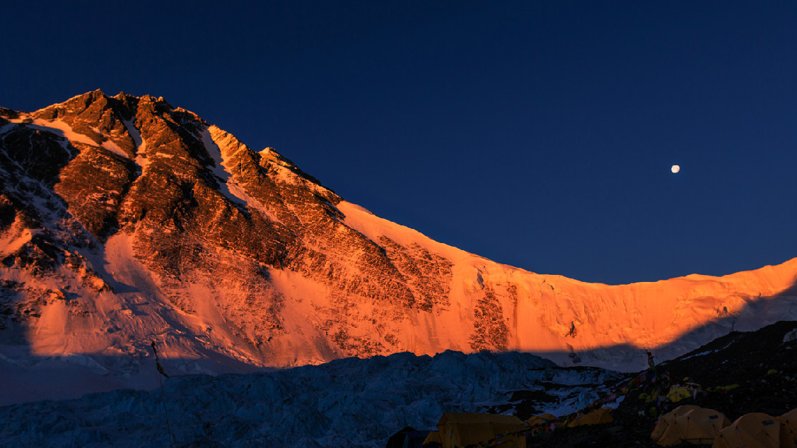
THANKS

